Slide 1
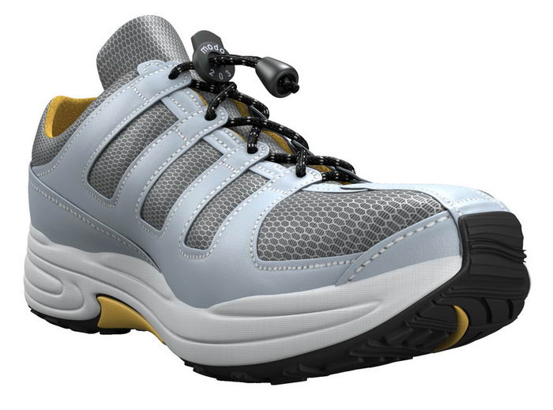
Do shoes affect your time online?
We found out

Slide 2
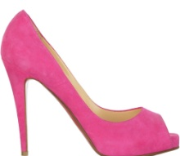
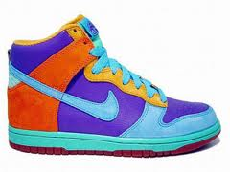
Which would happen?
A person with a lot of shoes might care a lot about their looks and spend a lot of time on Facebook and other social media. This would cause them to spend a lot of time online
A person with a lot of shoes might care about their looks and be popular. A popular person might spend more time with their friends than on the internet.

Slide 3
We used a sheet like this to collect data from three 6th grade classrooms
Question Paper
Please take this serious, this is not for fun. Please give a sensible answer. There is no right or wrong answer. Give answers that are suitable for you, not your friends. Please write clearly, (preferably print.) This data is needed for a project in math.
Student’s Name:
How many pairs of shoes do you have?
How much time do you spend online? (in hours)

Slide 4
Time Online (hours) | Pair of Shoes |  | Time Online (hours) | Pair of Shoes |  | Time Online (hours) | Pair of Shoes
2 | 12 |  | 6 | 4 |  | 2 | 3
0.5 | 6 |  | 4 | 12 |  | 1 | 11
2 | 13 |  | 3 | 6 |  | 2.5 | 15
5 | 6 |  | 1 | 3 |  | 1 | 28
1.5 | 3 |  | 2 | 12 |  | 6 | 2
6 | 2 |  | 1 | 4 |  | 0.25 | 11
3 | 3 |  | 5 | 13 |  | 1 | 10
1.5 | 2 |  | 3 | 6 |  | 0.5 | 17
3 | 2 |  | 7 | 2 |  | 2 | 6
1 | 1 |  | 4 | 1 |  | 4 | 7
3 | 1 |  | 1.5 | 4 |  | 0.5 | 13
2.5 | 3 |  | 0.25 | 5 |  | 2 | 13
3 | 26 |  | 3.5 | 3 |  | 2 | 20
4 | 10 |  | 1 | 6 |  | 1.5 | 2
2 | 6 |  | 3 | 8 |  | 1 | 5
1 | 11 |  | 0.25 | 5 |  | 1 | 13
4 | 5 |  | 6 | 14 |  | 64 | 3
2 | 3 |  | 7.5 | 3 |  | 12 | 6
1 | 3 |  | 1 | 2 |  | 16 | 5
1 | 1 |  | 1 | 5 |  | 20 | 2
 |  |  |  |  |  | Note the numbers in | red are not use.
This is the information we collected.

Slide 5
Here are our results
There is no correlation between the number of shoes someone owns and the amount of time they spend online. If we were going to fit a line of best fit to it, it would be a weak negative correlation.
Notes:
Put graph here

Slide 6
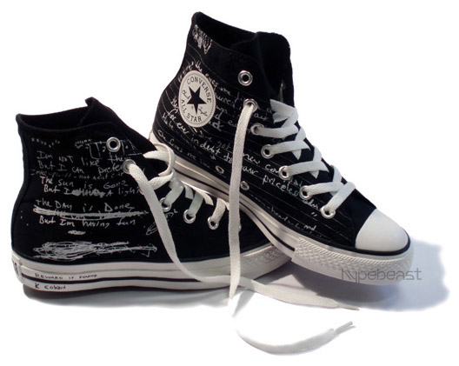
Prediction
The equation for our line of best fit is Y=1.33x-7.31. So, if somebody spent 9 hours online, they might have about five pairs of shoes.

Slide 7
In conclusion, there is no relationship between the number of shoes a middle school students have and the amount of time they spend online.

