Slide 1
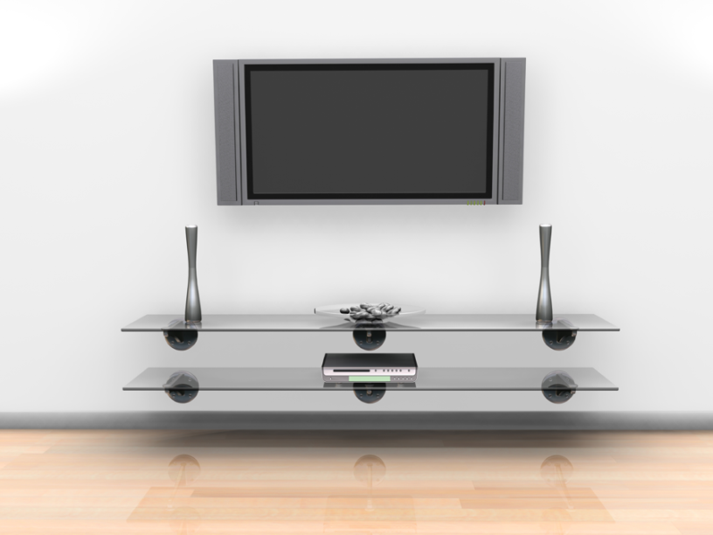
Number of T.V.’s
Vs.
Hours of Watching
By: Camryn Holly,
Hannah Chrome,
Makayla Hostetler,
& Emily Harns

Slide 2
Our Hypothesis
There is a weak, positive correlation between the number of T.V.s a person has in their house and the number of hours a day they spend on the T.V.

Slide 3
Our Polling Tool
Name:__________________________________
Please fill out the following information:
1.)How many T.V.s do you have in your house?__________________
2.)How many hours a day do you spend on your T.V.? (Wii, X-box, watching shows, etc.)______________________________

Slide 4
Name | # of T.V.s in a house | Hours a day spent on the T.V.
Abigail | 4 | 0.5
Michael S. | 2 | 3
Jacob H. | 4 | 5
Austin A. | 5 | 2
Brett B. | 2 | 2
Sam P. | 3 | 5
Rachel E. | 6 | 3
Chris F. | 4 | 1
Dylan T. | 4 | 2
Jayden E. | 6 | 2.5
Brittney B. | 5 | 2.5
Will M. | 7 | 5
J.J. | 3 | 5
Ashlynn B. | 2 | 3
Julia S. | 3 | 4
Taylor B. | 4 | 1.5
Jessica L. | 6 | 5
Sam C. | 3 | 5
Jacob S. | 3 | 3
Vonya | 4 | 1
Zach | 8 | 5
Taylor | 10 | .5
Zack | 4 | 1.5
Chandler | 3 | 0.5
Malissa | 5 | 2.5
Adam | 3 | 3.5
Claire | 2 | 0.5
Nathan | 5 | 5
Owen | 3 | 2.5
Austin | 5 | 1
Taylor L. | 4 | 2
Abbey | 4 | 3
Emily A. | 4 | 0.5
Rachel W. | 11 | 1
Jonni | 6 | 6
Garret | 7 | 2
Our Data List

Slide 6
Weak, Positive
But if there was a correlation
it would be:
Line of Best Fit
Correlation=None

Slide 7
Our points:
~3,1
~4,2
Our Calculations
Our process:
1.) 2-1= 1
4-3= 1
Y=1x-2
2.) 2=4(1)+b
3.) 2= 4 + b
-4 -4
4.) -2=b

Slide 8
prediction
If you have 13 T.V.s in your house, based on our formula (y=1x-2) you would watch 11 hours of T.V. a day.

Slide 9
Middle school students expected behavior
For every 4 T.V.s a middle school student has…
They will watch 2 hours of T.V. each day.

Slide 10
Thanks for watching☺

