Slide 1
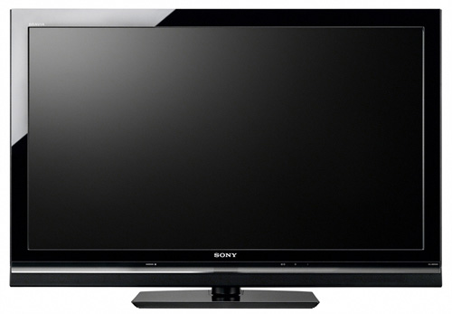
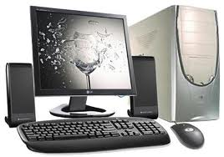
T.V.s vs. Computers
By: Jarod Chrome, Tommy Treloar and Caleb Silsby

Slide 2
Hypothesis
We think there is a weak, positive correlation between the amount of T.V.s and working computers and laptops in a students home.

Slide 3
Our Survey Polling Tool
Please print your first and last name on the line given. Jimmy Jons
Please list the amount of these things that are in your home.
T.V.s: 3 Working Computers
and Laptops: 1
Note: Your data will be used in a graded survey for Mr. Lator’s advanced math class.
Thank you!

Slide 4
Our List of Survey Data
Student Names | Amount of T.Vs in home | Amount of working Computers and Laptops in home
Sarah Brown | 4 | 6
Andrew Peffers | 4 | 5
Ben Dever | 0 | 0
Josh Geyer | 2 | 4
Nick Mumby | 4 | 6
Lucas Barnes | 3 | 1
William White | 2 | 4
Zach Ferguson | 5 | 5
Zoe Spencer | 8 | 4
Seth Coun | 4 | 5
Marysa Wilburn | 7 | 4
Matthew Hoffmann | 2 | 7
Kailey Deweerd | 5 | 5
Keegan Cleary | 4 | 2
Kaista B. | 4 | 3
Lillian Droscha | 1 | 1
Athena Bryer | 4 | 3
Hannah Seboll | 5 | 2
Teddy Largo | 5 | 1
Fifi Larue | 6 | 3
Micaela Fahanbach | 3 | 4
Cole Crandell | 6 | 4
Christine Brayton | 7 | 2
Jesus Mendez | 9 | 8
Mallory Matthews | 5 | 4
Carson Niswonger | 9 | 4
Jasmine Douglas | 4 | 4
Hatixhe Pira | 2 | 3
Jared Ramnsey | 4 | 2
Jj Van Splintern | 5 | 3
Tristan Pease | 6 | 10
Claudia Vondra | 6 | 1
Sophia Lopez | 5 | 2
Dallas Goff | 3 | 1
Bre Virag | 7 | 4
Nick Hischke | 6 | 2
Addison Voss | 3 | 3
Dakota Loomis | 0 | 0
Cristian Coats | 4 | 1
Thailia Richards | 5 | 3
Kyle Crone | 4 | 1
Breanne Weigelt | 3 | 1
Jamie Rice | 4 | 2
Will Munzeneimier | 3 | 3
Miya Ballard | 4 | 7
Christine H. | 1 | 3
Bri Lound | 8 | 1
Chloe | 6 | 3
Ben Davis | 5 | 10
Steve | 11 | 4
Dean | 5 | 2
Eddie | 4 | 2
Jake | 3 | 1
Zack | 4 | 1
Ben C. | 6 | 2
Callie | 3 | 2
Leah | 3 | 1
Scott | 3 | 3
Tyler | 4 | 1
Max H | 3 | 4
Michael | 1 | 7
Neeraj | 4 | 4
Charlie | 3 | 4
Johnna | 5 | 5
Jj M. | 3 | 3
Garret | 7 | 2
Jerrod | 4 | 5
Matt | 4 | 4

Slide 5
Our Scatter Plot
Number of Surveys with the same answer:
1 surveys
2-3 surveys
4-6 surveys

Slide 6
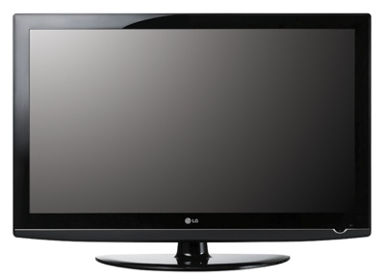
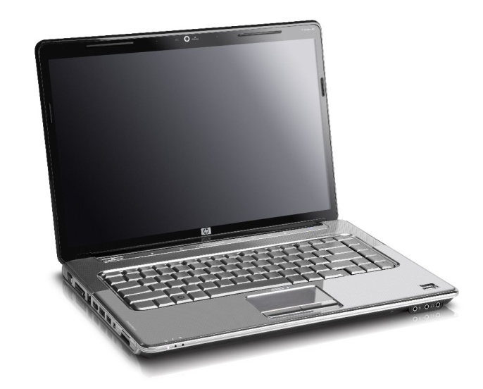
Our Conclusion
We conclude that our data collected shows that there is a no correlation relationship between the amount of T.V.s and working computers and laptops in a students home.
VS.

Slide 7
But if there was…
The correlation would be weak, positive if there was a correlation.

Slide 8
Calculation and equation for line of best fit
(o,o) (4,3)
3-0 = 3 = .75
4-0 4
= Y=.75x+0
3=.75*4+b
3=3+b
-3=-3
0=b
Equation
Calculation

Slide 9
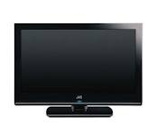
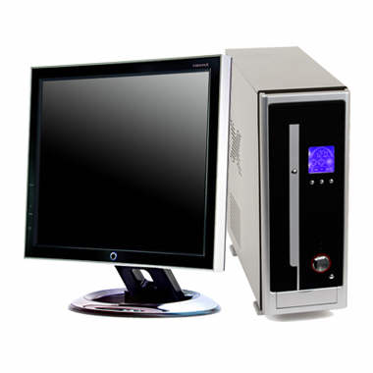
Our Prediction
Our prediction for a point that is not on the scatter plot concluded that if there was 8 T.V.s in a students home, they would have 6 computers. We came to this by using our equation for our line of best fit if we had one. The math looks like this:
Y=.75*8+0
.75*8=6
6+0=6
Y=6 computers

Slide 10
Summary of expected middle school student behavior
After going through our data, we found that the most common answer for the amount of T.V.s and working computers and laptops in a student’s house is 3 T.V.s and 1 working computer or laptop. That concludes that if we surveyed a middle school student at random, their most common answer would be 3 T.V.s and 1 computer or laptop. It also means that most middle school students have this combination in their home.

Slide 11
Thank you for watching our PowerPoint!

